Slide 1

JavaJam Coffe Website
By: Juan Artiles

Slide 2
Does it meet expectations?
Desired pages present
Home Page
Menus Page
Performance Page
Job Opportunity Page
Easy to Navigate
Allows for user input and contribution
Promotes local and its products

Slide 3
Components and Benefits
Drinks Component
FAQ Component

Slide 4
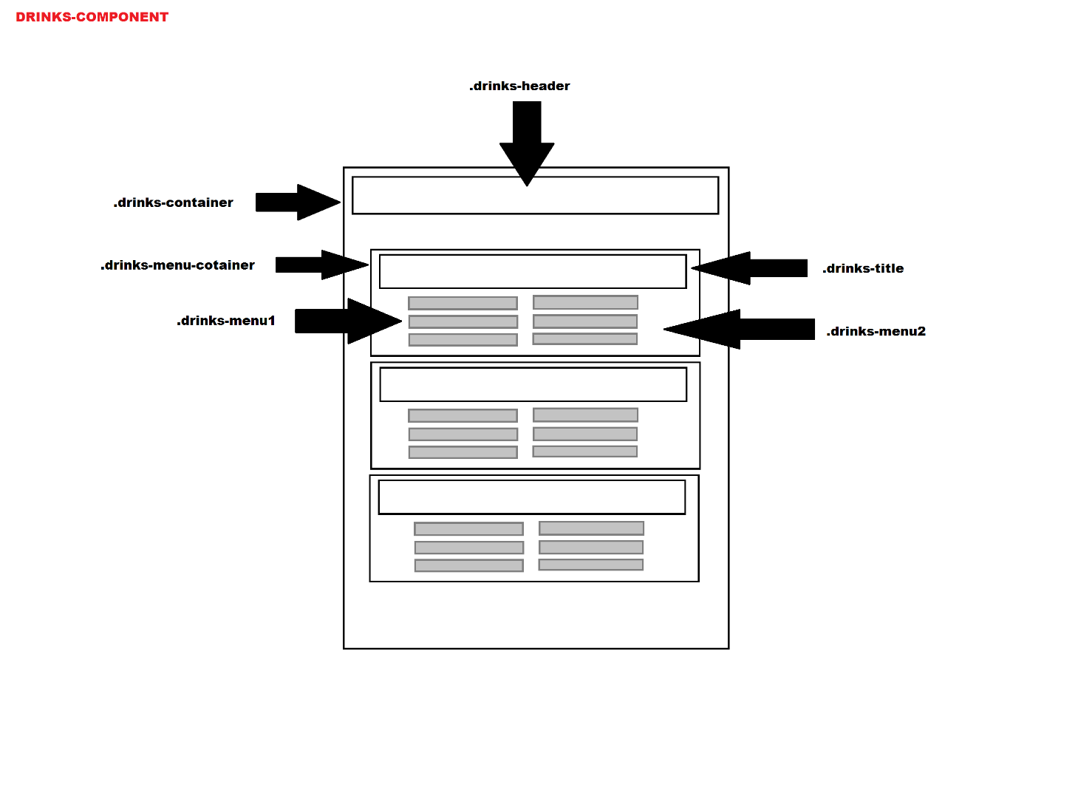
Drinks

Slide 5
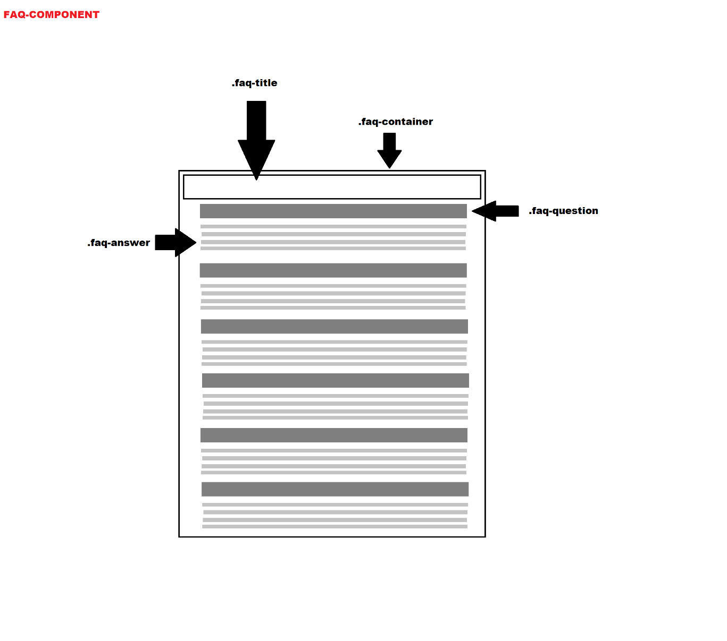
FAQ

Slide 6
Should you buy?
Simple and to the point
Fulfills basic needs and a little more
Assets are quick and easy to use

